Slide 1

My Friend the wish-granter
Boku no shinyuu wa, kanaeru hito da
(Wish-granter Project)
By：Chew Nicholas Jun Cheng
Genre: Visual Novel
Game Engine: Unity
Players: 1
Target Audience: 10-20 yrs

Slide 2
Summary
Two high school boys grant the wishes of many people.
One of the main characters is afflicted by a certain curse. When he hears a wish with strong desires, he transforms into a shikigami. The other main character helps him grant these wishes.
A story about meeting many ayakashi and youkai, making new friends, and resolving problems.
Puzzles and overworld gameplay are planned to be added in the future.

Slide 3
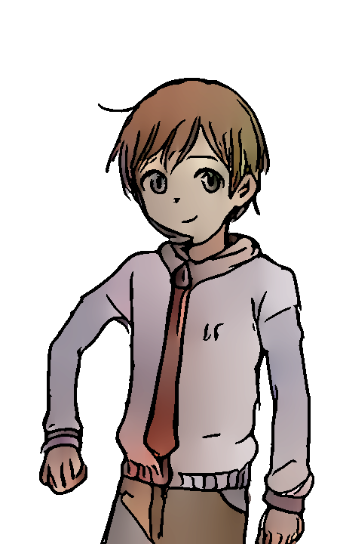

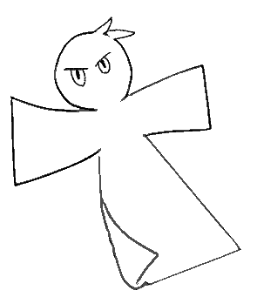
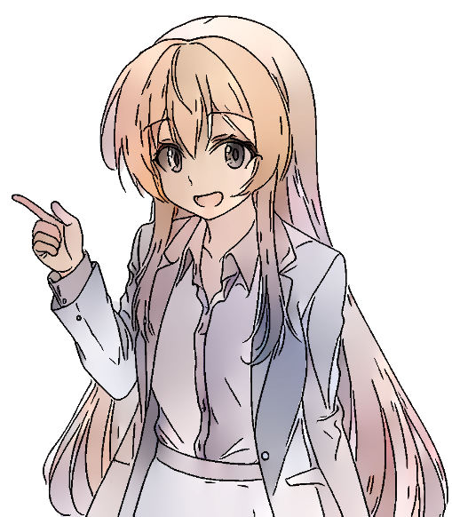
Character Concepts
Takeshi’s shikigami form
MC: Kano Makoto
Studious and friendly. He helps Takeshi grant wishes.
2nd year high school.
MC: Akiyama Takeshi
Aloof, but cares greatly for his friends. Due to the curse, he has no choice but to grant people's wishes.
2nd year high school.
Tachibana Ayase
Friendly lady in the neighborhood. Has known Takeshi since childhood and is friends with Makoto.
Young adult.

